Slide 1

Accelerating Multi-threaded Application Simulation Through Barrier-Interval Time-Parallelism
Paul D. Bryan, Jason A. Poovey, Jesse G. Beu, Thomas M. Conte
Georgia Institute of Technology

Slide 2
Outline
Introduction
Multi-threaded Application Simulation Challenges
  Circular Dependence Dilemma
  Thread Skew
Barrier Interval Simulation
Results
Conclusion

Slide 3
Simulation Bottleneck
Simulation is vital for computer architecture design and research
  importance of reducing costs:
    decreases iterative design cycle
    more design alternatives considered
    results in better architectural decisions
Simulation is SLOW
  orders of magnitude slower than native execution
  seconds of native execution can take weeks or months to simulate
Multi-core designs have exacerbated simulation intractability

Slide 4
Computer Architecture Simulation
Cycle accurate simulation run for all or a portion of a representative workload
  Fast-forward execution
  Detailed execution
Single-threaded acceleration techniques
  Sampled Simulation
  SimPoints (Guided Simulation)
  Reduced Input Sets

Slide 5
Circular Dependence Dilemma
Progress of threads dependent upon:
  implicit interactions
    shared resources (e.g., shared LLC)
  explicit interactions
    synchronization
    critical section thread orderings
      dependent upon:
        proximity to home node
        network contention
        coherence state
Circular Dependence
System
Performance
Thread
Performance
Notes:
Consider the common practice of skipping past initialization code before simulating
For single-threaded simulation:
state is known (at least, it can be approximated)
no other programs are running
no interleaving issues
For multi-threaded simulation:
state known if skipping terminates during sequential region
state unknown for other regions
must predict relative progress of all threads
Caveat:
Small timing perturbations can have large impact on performance measurements

Slide 6
Thread Skew Metric
Measures the thread divergence from actual performance:
  Measured as #Instructions difference in individual thread progress at a global instruction count
  Positive thread skew → thread is leading true execution
  Negative thread skew → thread is lagging true execution

Slide 7
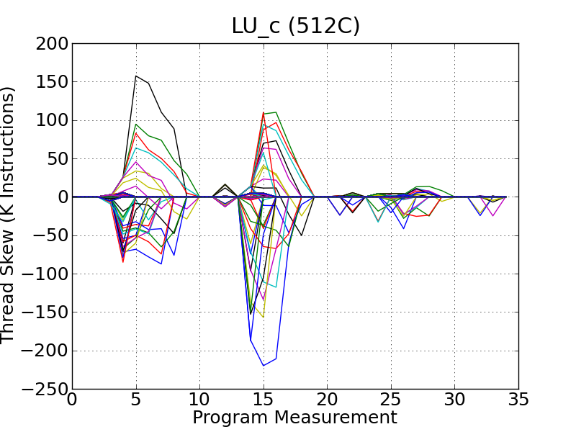
Thread Skew Illustration
Barriers

Slide 8
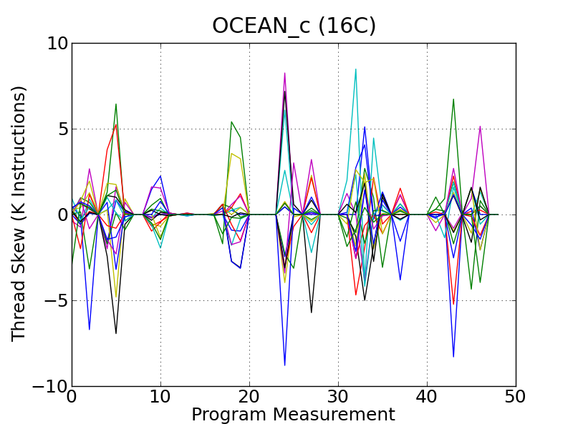
Thread Skew Illustration
Notes:
Thread Skew values tend to increase with imprecise schedules
Barriers create convergence points
Thread Skew must converge to zero at barrier releases
relative progress of all threads are known
problem of predicting thread progress is avoided
Barriers provide natural segmentation points to leverage time-parallel simulation

Slide 9
Outline
Introduction
Multi-threaded Application Simulation Challenges
  Circular Dependence Dilemma
  Thread Skew
Barrier Interval Simulation
Results
Conclusion

Slide 10
Barrier Interval Simulation (BIS)
Break the benchmark into “barrier intervals”
  Execute each interval as a separate simulation
  Execute all intervals in parallel
Notes:
metrics can be obtained through appropriate means

Slide 11
Barrier Interval Simulation (BIS)
Once per workload
  Functional fast-forward to find barriers
BIS Simulation
  Interval Simulation skips to barrier release event
  Detailed execution of only the interval
Notes:
metrics can be obtained through appropriate means

Slide 12
Barrier Interval Simulation (BIS)
Cold-start effects
  Warmup for 10k,100k,1M,10M instructions prior to barrier release event
  Warms-up cache, coherence state, network state, etc.
Notes:
metrics can be obtained through appropriate means

Slide 13
Outline
Introduction
Multi-threaded Application Simulation Challenges
  Circular Dependence Dilemma
  Thread Skew
Barrier Interval Simulation
Results
Conclusion

Slide 14
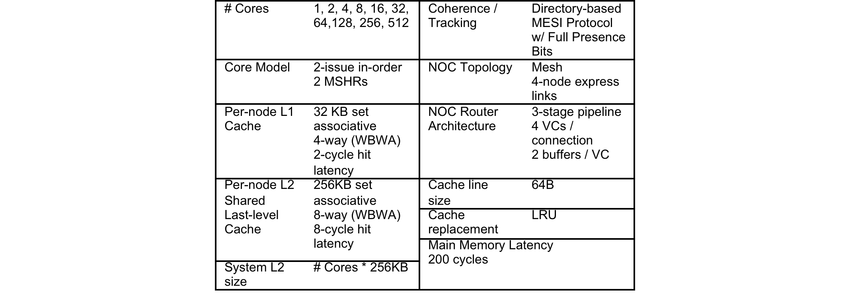
Experimental Methodology
Cycle accurate manycore simulation (details in paper)

Slide 15
Experimental Methodology
Subset of SPLASH-2 evaluated
Detailed warm-up lengths:
  none, 10k, 100k, 1M, 10M
Evaluated:
  Simulated Execution Time Error (percentage difference)
  Wall-Clock Speedup
181,000 simulations to calculate simulated speedup (wall-clock speedup)

Slide 16
Experimental Methodology
Metric of interest is speedup
Measure execution time
  Since whole program is executed,
  cycle count = execution time
Evaluation
  Error rates
  Simulation speedup/efficiency
  Warmup sizing

Slide 17
Error Rates – Cycle Count

Slide 18
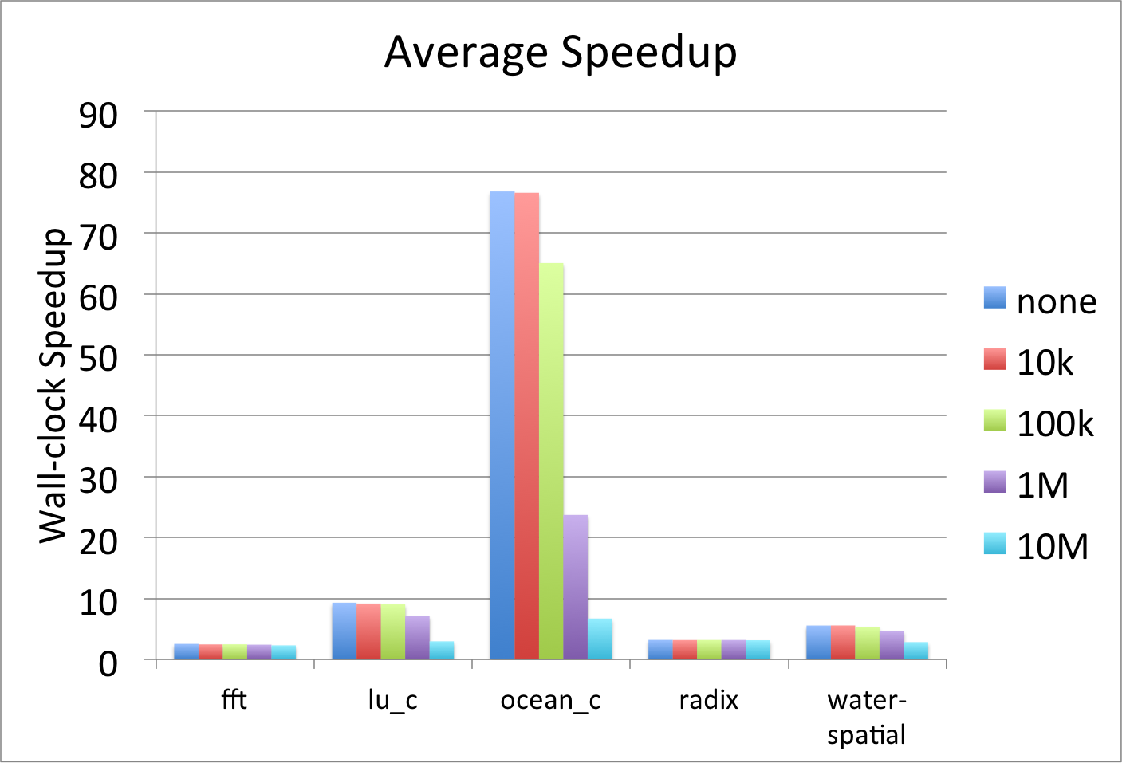
Results - Speedup

Slide 19
BIS Speedup Observations
Max speedup is dependent upon two factors:
  homogeneity of barrier interval sizes
  the number of barrier intervals
Interval heterogeneity measured through the coefficient of variation (CV)
    lower CV → higher heterogeneity

Slide 20
Speedup Efficiency
Relative Efficiency = max speedup / # barriers
Lower CV:
  → higher relative efficiency
  → higher speedup

Slide 21
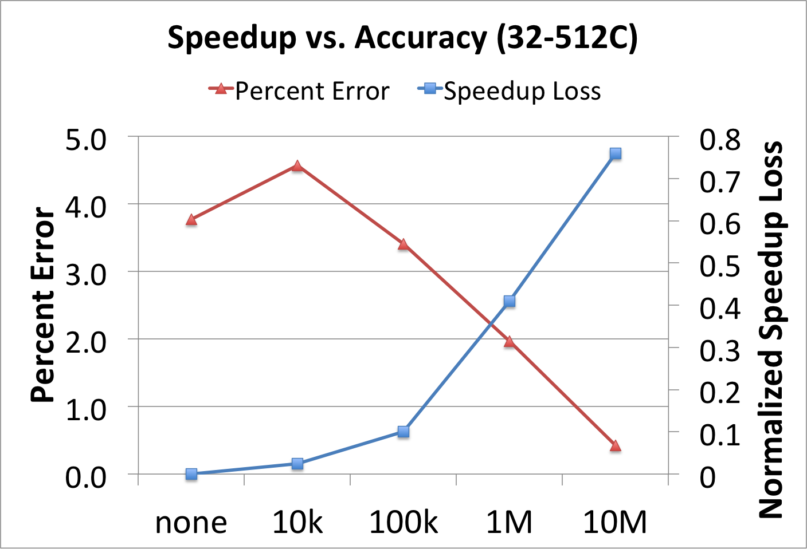
Speedup vs. Accuracy (32-512C)

Slide 22
Warm-up Recommendations
Increasing warm-up decreases wall clock speedup
  more duplicate work from overlapping interval streams
  want “just enough” warm-up to provide a good trade-off between speed and accuracy
  recommendation: 1M pre-interval warm-up

Slide 23
Speedup Assumptions
Previous experiments assumed infinite contexts to calculate speedup
  ok for workloads with small # barriers
  unrealistic for workloads with high barrier counts
What is the speedup if a limited number of machine contexts are assumed?
  used a greedy algorithm to schedule intervals

Slide 24
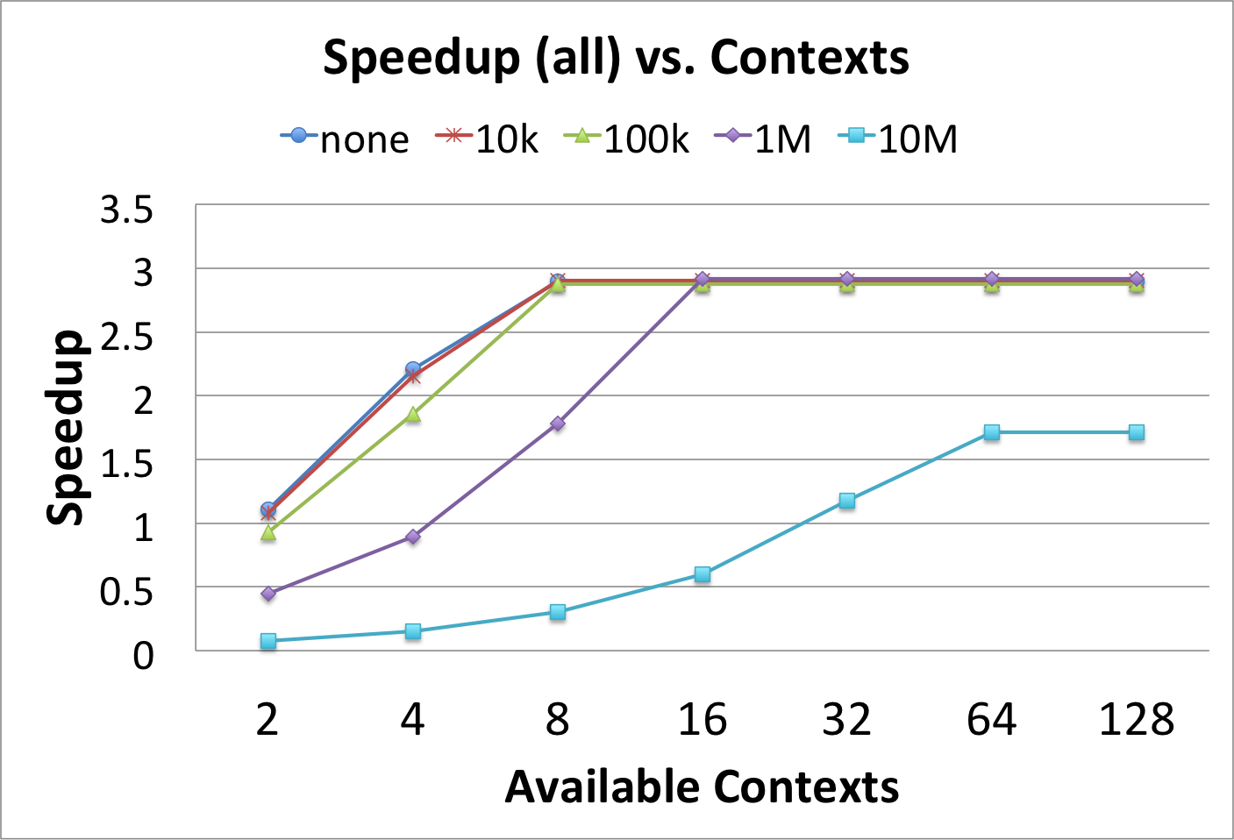
Speedup with Limited Contexts

Slide 25
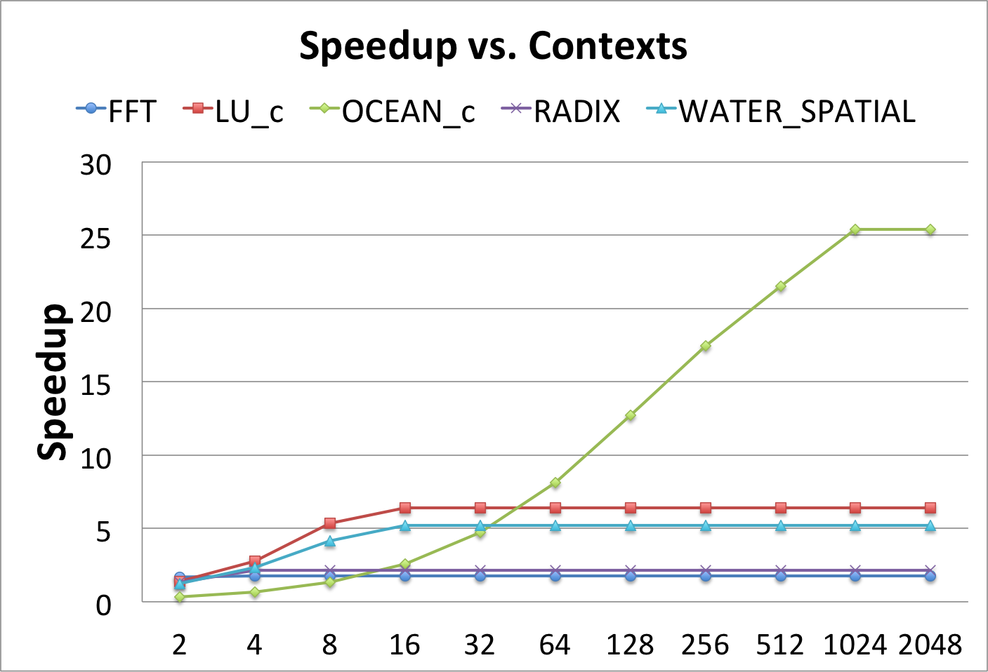
Speedup with Limited Contexts

Slide 26
Future Work
Sampling barrier intervals
  Useful for throughput metrics such as cache miss rates
More workloads
  Preliminary results are promising on big data applications such as Graph500
Convergence point detection for non-barrier applications

Slide 27
Conclusion
Barrier Interval Simulation is effective at simulation speedup for a class of multi-threaded applications
0.09% average error and 8.32x speedup for 1M warm-up
Certain applications (i.e., ocean) can benefit significantly
  speedup of 596x
Even assuming limited contexts, attained speedups are significant
  with 16 contexts → 3x speedup

Slide 28
Thank You!
  Questions?

Slide 29
Bonus Slides

Slide 30
Bonus Slides

Slide 31
Bonus Slides

Slide 32
Bonus Slides

Slide 33
Bonus Slides
Figure - Thread skew is calculated using aggregate system and per-thread fetch counts. Simulations with functional fast-forwarding record fetch counts for all threads at the beginning of a simulation. Full simulations use these counts to determine when fetch counts are recorded. Since total system fetch counts are identical in the fast-forwarded and full simulations, the sum of thread skew for every measurement must be zero. Individual threads may lead or lag their counterpart in the full simulation.

